Slide 1
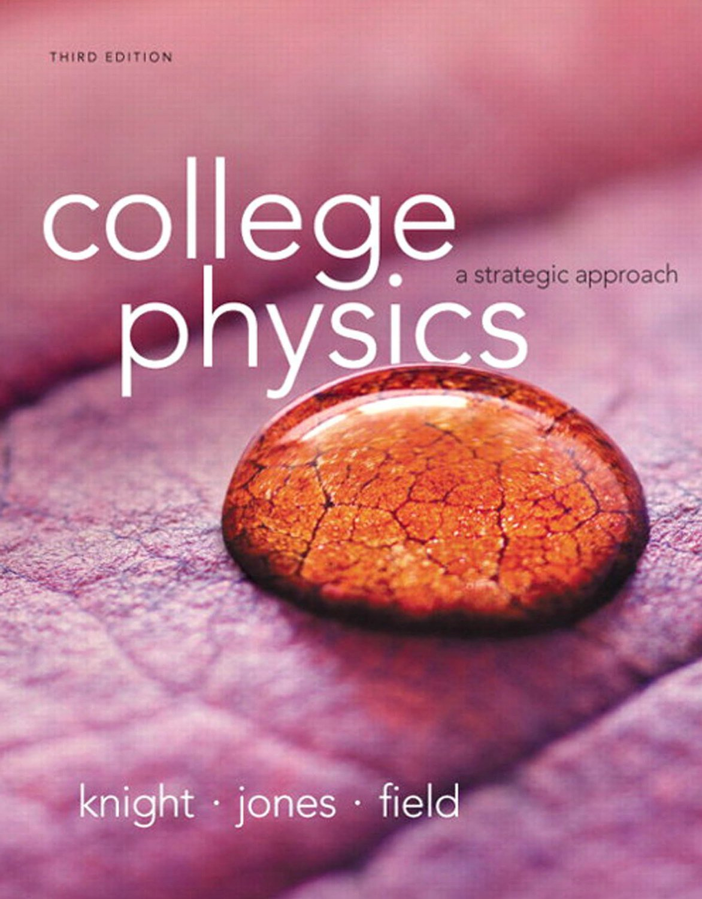
Chapter 6
Circular Motion, Orbits, and Gravity

Slide 2
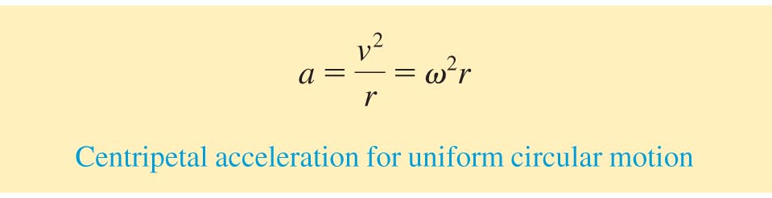
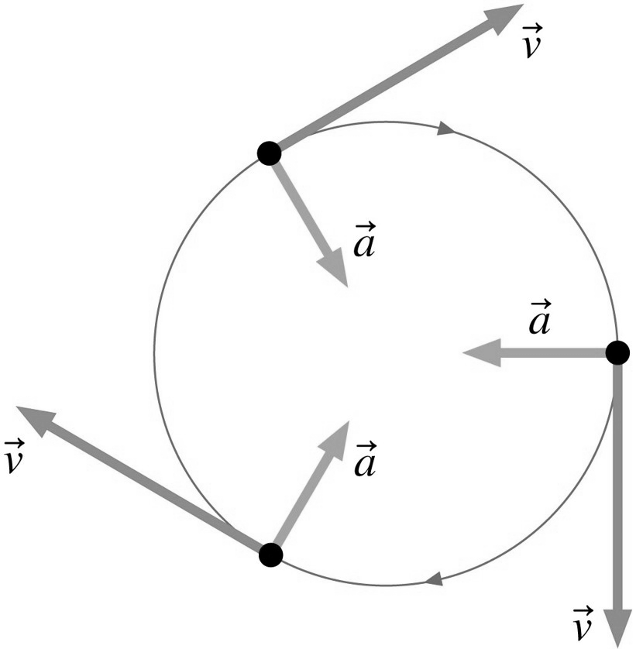
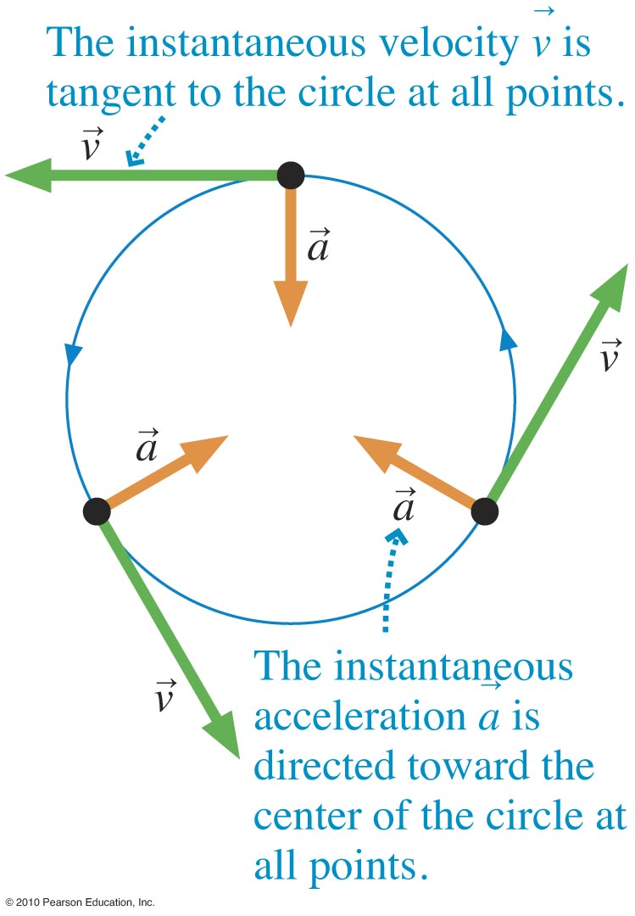
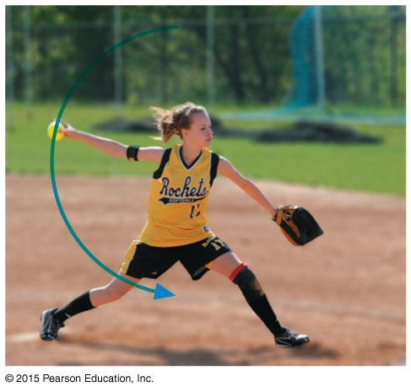

Uniform Circular Motion
Slide 6-23

Slide 3
For uniform circular motion, the acceleration
is parallel to the velocity
is directed toward the center of the circle
is large for a larger orbital the same speed
is always due to gravity

Slide 4
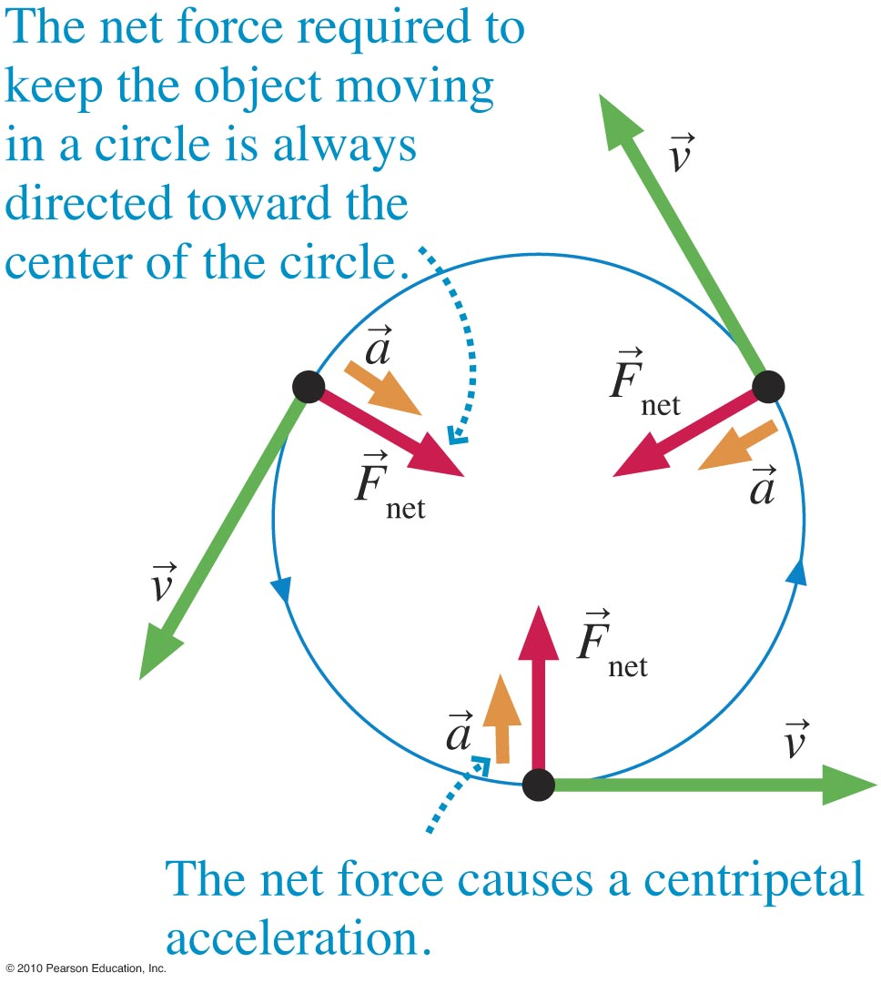
Forces in Circular Motion
Slide 6-24

Slide 5
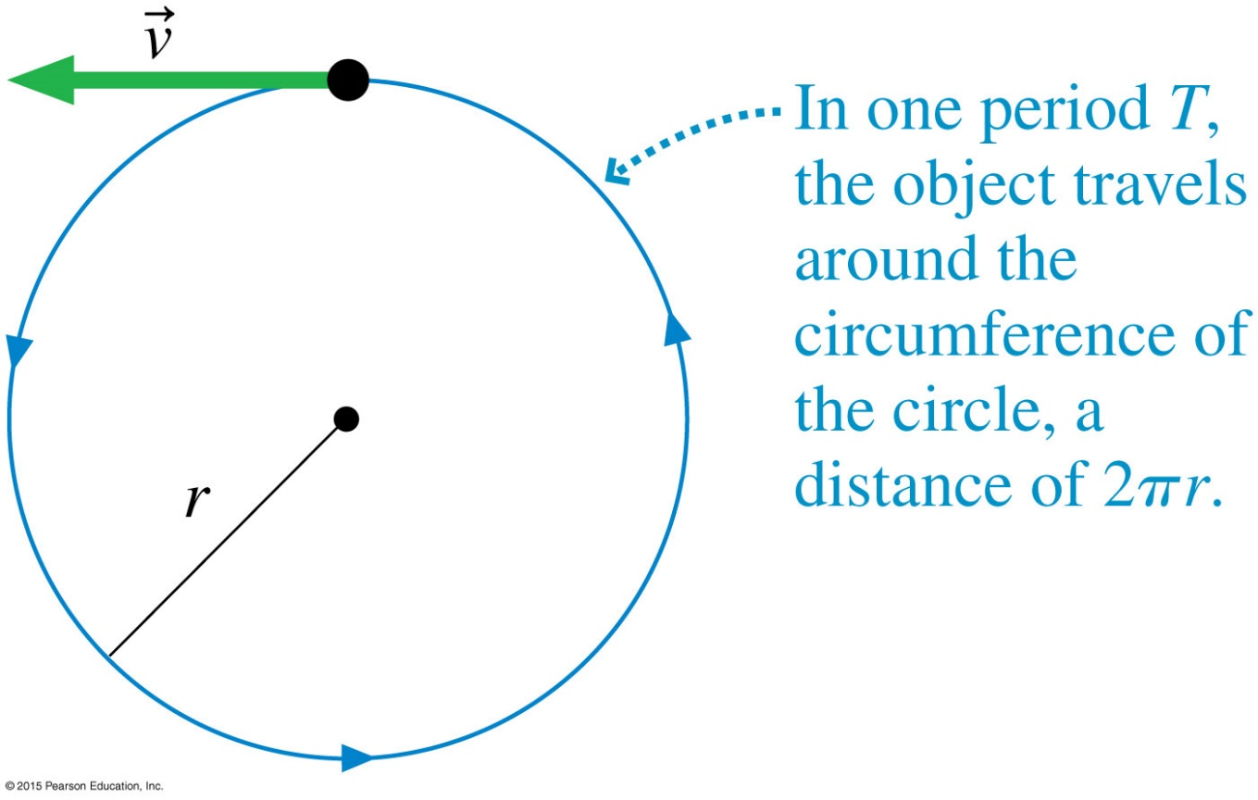

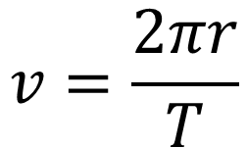

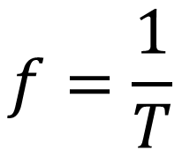
Time of Circular Motion
$$f=\frac{1}{T}$$
The frequency is just the inverse of the period
Example of frequency units:
$$\frac{\text{rev}}{\text{min}}$$
$$v=\frac{2πr}{T}$$
$$v=2πrf$$
Notes:
FIGURE 6.3

Slide 6
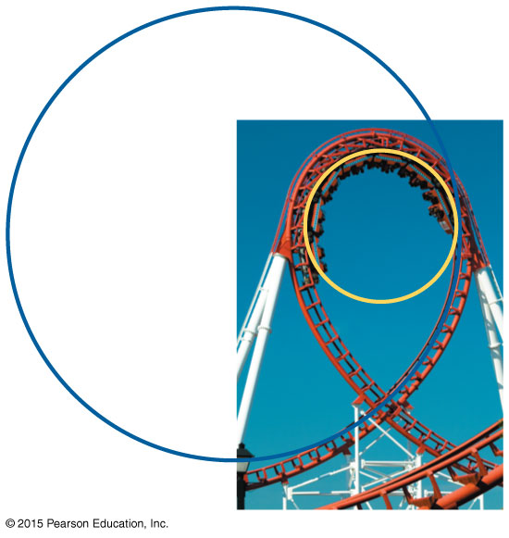
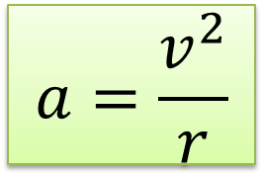
What happens when speed decreases and radius decreases?
$$a=\frac{v^{2}}{r}$$
Notes:
FIGURE Q6.15

Slide 7
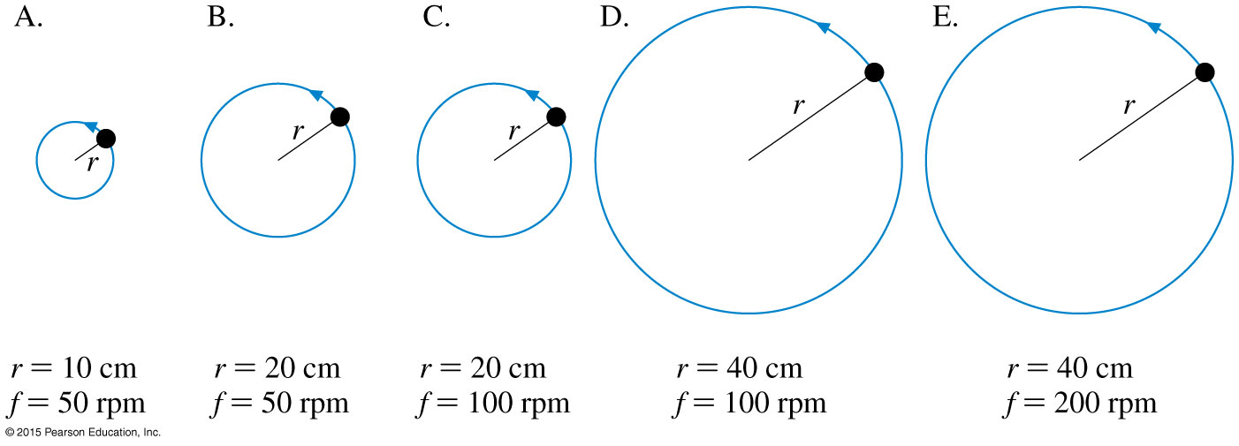
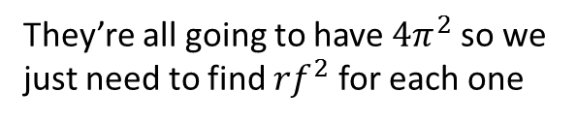
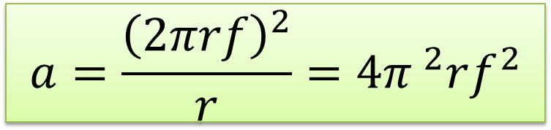

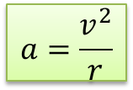
Comparing centripetal accelerations
Rank the acceleration of the following uniform circular motions from smallest to largest:
$$v=2πrf$$
$$a=\frac{v^{2}}{r}$$
They’re all going to have $4π^{2}$ so we just need to find ${rf}^{2}$ for each one
$$a=\frac{{\left(2πrf\right)}^{2}}{r}=4{π }^{2}rf^{2}$$
1
2
3
4
5
Notes:
STOP TO THINK BOX 6.2

Slide 8










Comparing centripetal accelerations
Rank the acceleration of the following uniform circular motions from smallest to largest
$$v=2πrf$$
$$a=\frac{v^{2}}{r}$$
$$r_{1}f_{1}^{2}$$
$$r_{2}f_{2}^{2}$$
$$r_{3}f_{3}^{2}$$
$$r_{4}f_{4}^{2}$$
$$r_{5}f_{5}^{2}$$
$$\left(10\text{cm}\right){\left(50\frac{\text{rev}}{\text{min}}\right)}^{2}$$
$$\left(20\text{cm}\right){\left(50\frac{\text{rev}}{\text{min}}\right)}^{2}$$
$$\left(20\text{cm}\right){\left(100\frac{\text{rev}}{\text{min}}\right)}^{2}$$
$$\left(40\text{cm}\right){\left(100\frac{\text{rev}}{\text{min}}\right)}^{2}$$
$$\left(40\text{cm}\right){\left(200\frac{\text{rev}}{\text{min}}\right)}^{2}$$
1
2
3
4
5
Notes:
STOP TO THINK BOX 6.2

Slide 9
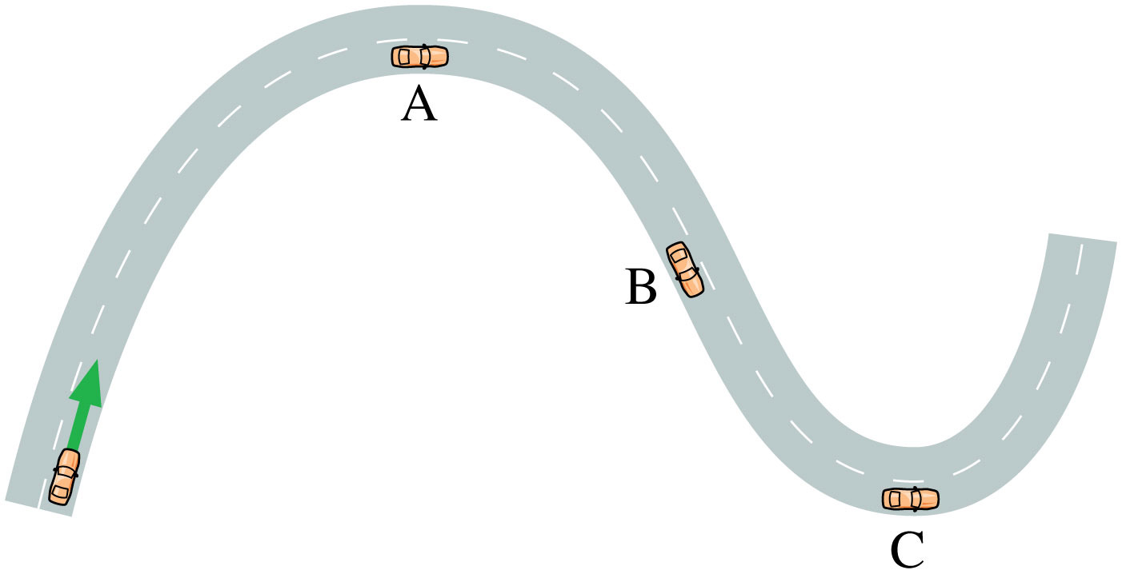


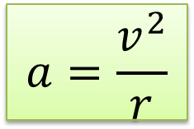
Driving on a curvy road
$$a=\frac{v^{2}}{r}$$
$$a=0$$
$$a=\frac{v^{2}}{r}$$
Notes:
FIGURE P6.51

Slide 10
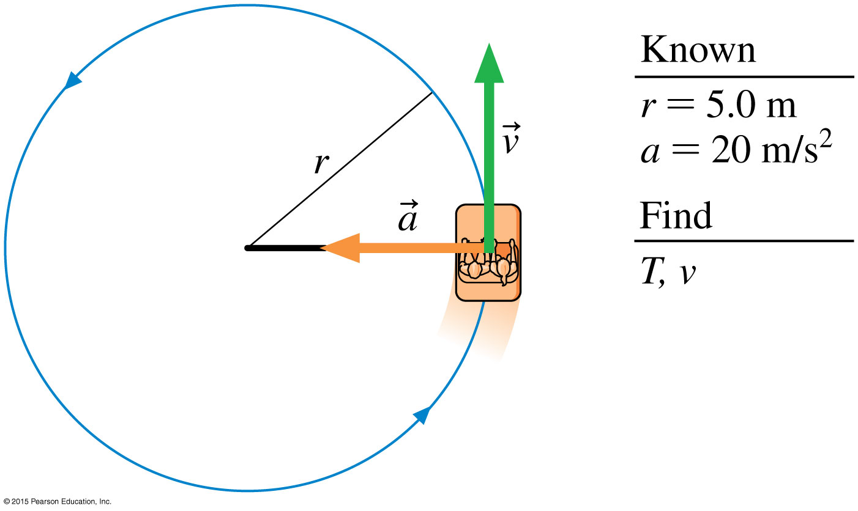

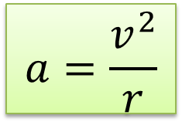
Problem solving uniform circular motion
$$v=2πrf$$
$$a=\frac{v^{2}}{r}$$
Notes:
FIGURE 6.4

Slide 11
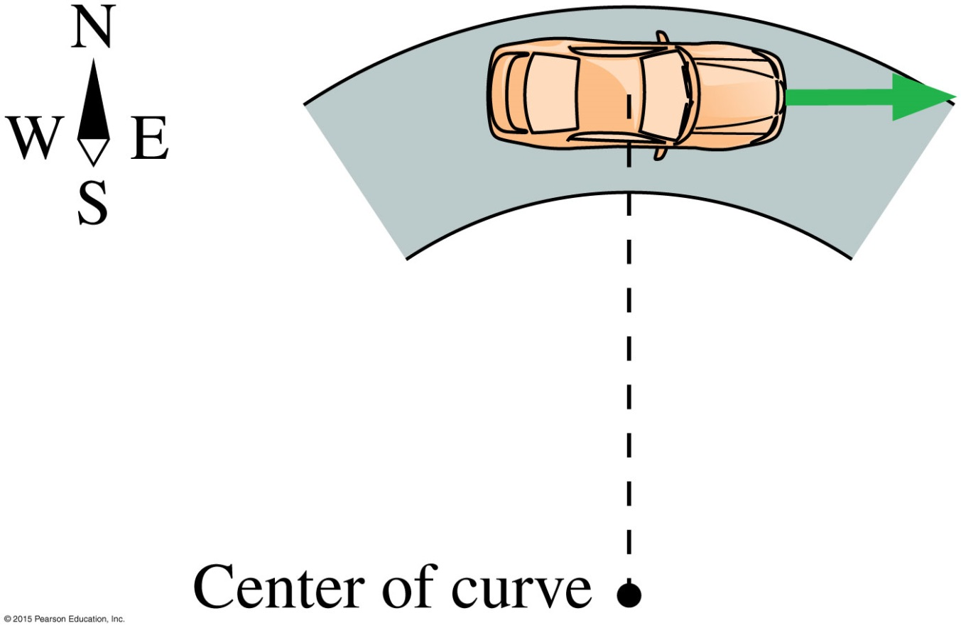
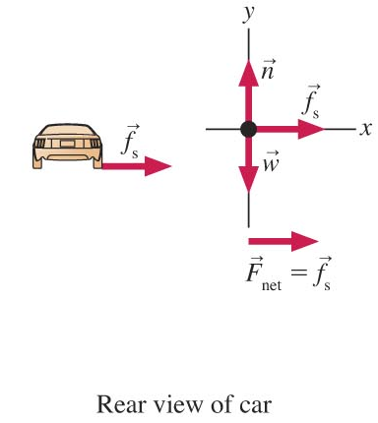
Problem solving uniform circular motion
A level curve on a country road has a radius of 150 m. What is the maximum speed at which this curve can be safely negotiated on a rainy day when the coefficient of friction between the tires on a car and the road is 0.40?
Slide 6-28

Slide 12


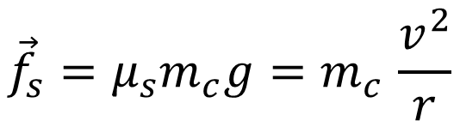

Problem solving uniform circular motion
A level curve on a country road has a radius of 150 m. What is the maximum speed at which this curve can be safely negotiated on a rainy day when the coefficient of friction between the tires on a car and the road is 0.40?
$${\vec{f}}_{s}=μ_{s}\vec{N}$$
$${\vec{f}}_{s}=μ_{s}m_{c}g{=m}_{c}\frac{v^{2}}{r}$$
$$v=\sqrt{μ_{s}gr}$$
Slide 6-28

Slide 13
When a car turns a corner on a level road, which force provides the necessary centripetal acceleration?
Friction
Tension
Normal Force
Air resistance
Gravity

Slide 14

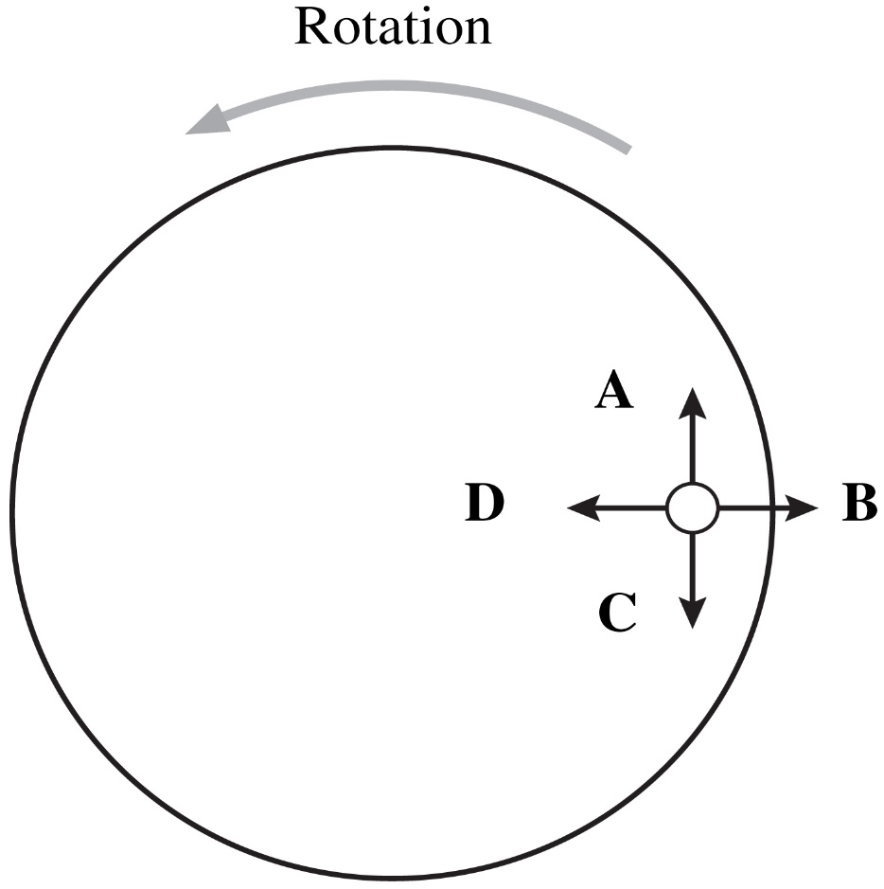
Additional Questions
A coin sits on a rotating turntable.
At the time shown in the figure, which arrow gives the direction of the coin’s velocity?
Slide 6-45
Notes:
Answer: A

Slide 15
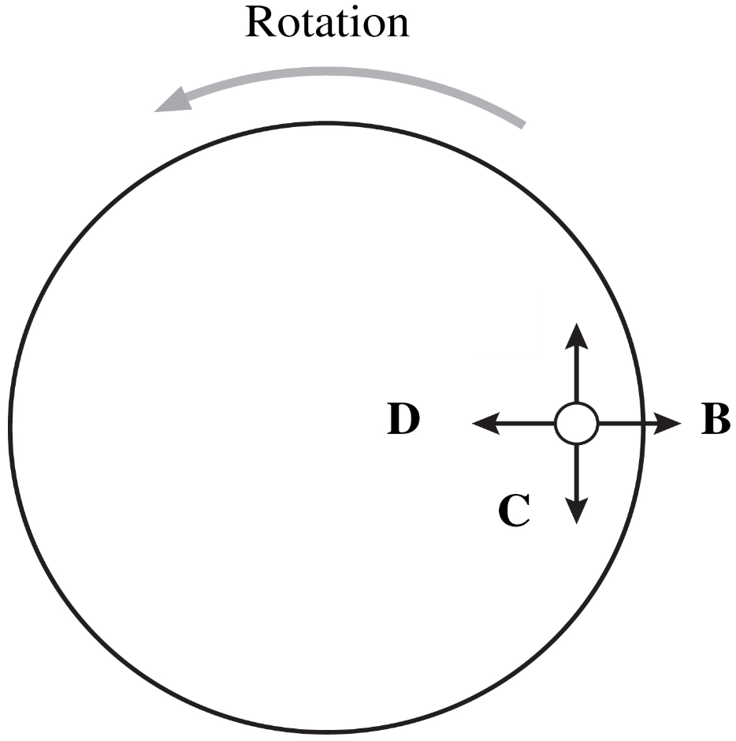
Answer
A coin sits on a rotating turntable.
At the time shown in the figure, which arrow gives the direction of the coin’s velocity?
A
Slide 6-46
Notes:
Answer: A

Slide 16
Additional Questions
A coin sits on a rotating turntable.
At the time shown in the figure, which arrow gives the direction of the frictional force on the coin?
Slide 6-47
Notes:
Answer: D

Slide 17
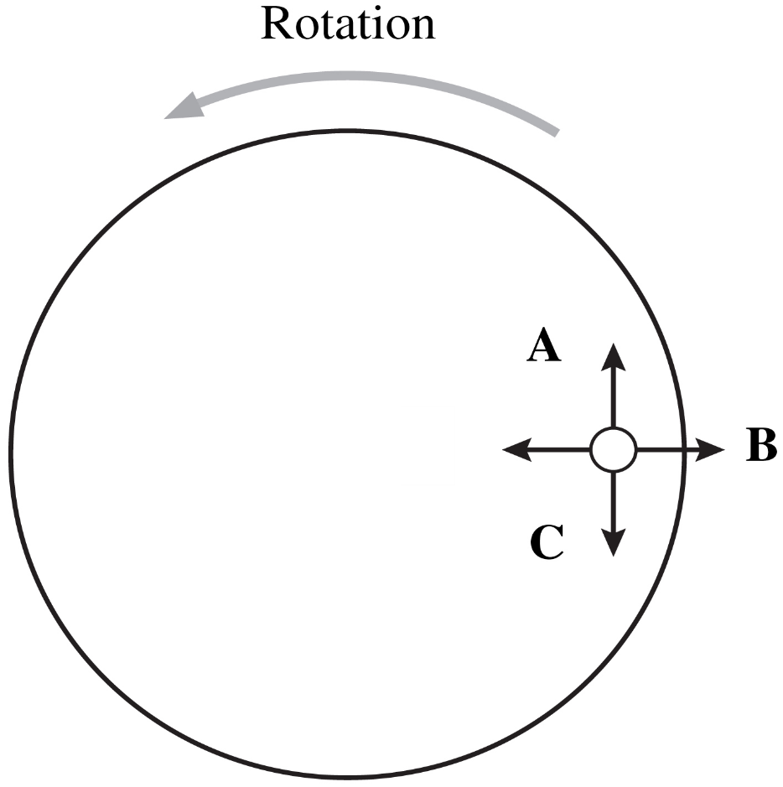
Answer
A coin sits on a rotating turntable.
At the time shown in the figure, which arrow gives the direction of the frictional force on the coin?
D
Slide 6-48
Notes:
Answer: D

Slide 18
Additional Questions
A coin sits on a rotating turntable.
At the instant shown, suppose the frictional force disappeared. In what direction would the coin move?
Slide 6-49
Notes:
Answer: A

Slide 19
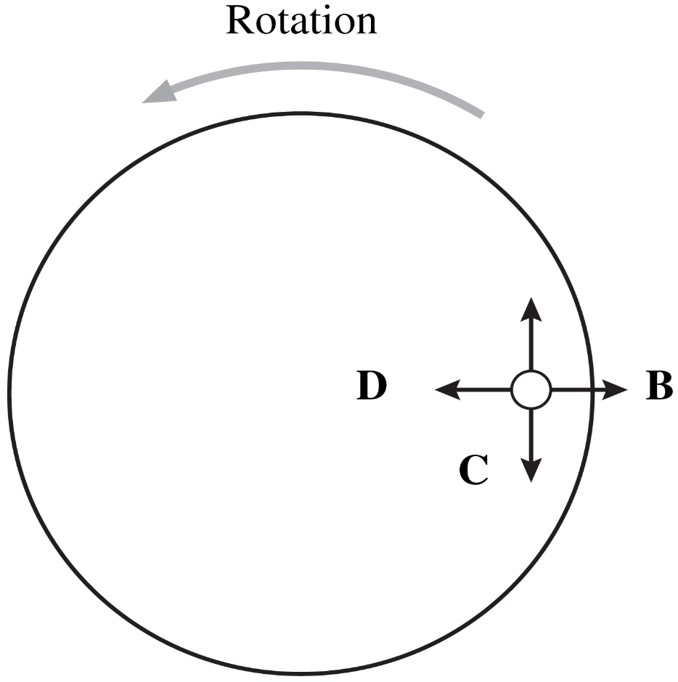
Answer
A coin sits on a rotating turntable.
At the instant shown, suppose the frictional force disappeared. In what direction would the coin move?
A
Slide 6-50
Notes:
Answer: A

Slide 20
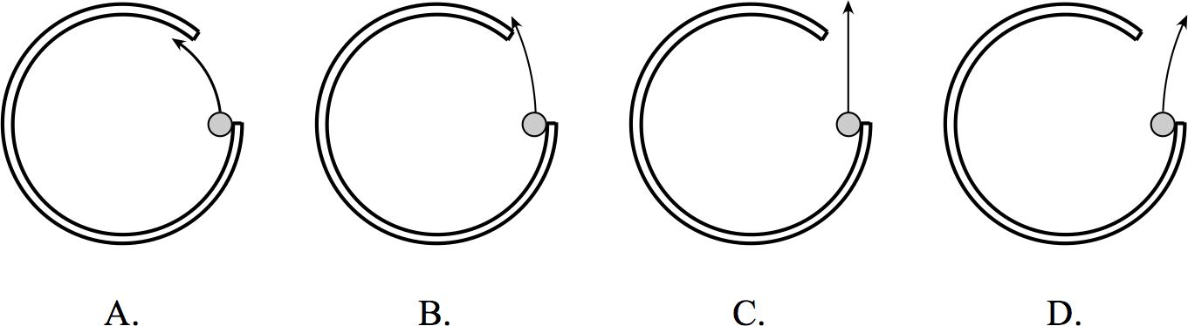
A ball moves CW in circular motion. What happens when it reaches the opening?
A
B
C
D

Slide 21
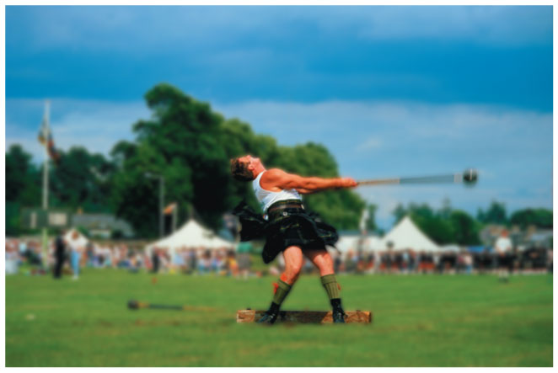
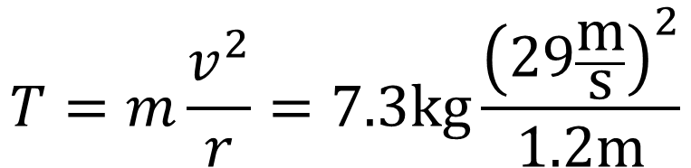

Problem solving uniform circular motion
In the hammer throw, an athlete spins a heavy mass in a circle at the end of a chain, then lets go of the chain. For male athletes, the “hammer” is a mass of 7.3 kg at the end of a 1.2 m chain.
$$m\frac{v^{2}}{r}$$
A world-class thrower can get the hammer up to a speed of 29 m/s. If an athlete swings the mass in a horizontal circle centered on the handle he uses to hold the chain, what is the tension in the chain?
$$T=m\frac{v^{2}}{r}=7.3\text{kg}\frac{{\left(29\frac{\text{m}}{\text{s}}\right)}^{2}}{1.2\text{m}}$$
Slide 6-29

Slide 22
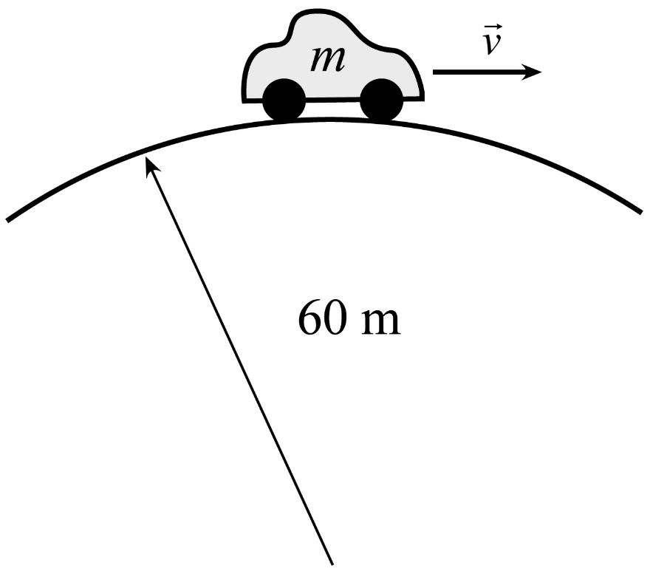

Problem solving uniform circular motion
A car of mass 1500 kg goes over a hill at a speed of 20 m/s. The shape of the hill is approximately circular, with a radius of 60 m, as in the figure at right. When the car is at the highest point of the hill,
What is the force of gravity on the car?
What is the normal force of the road on the car at this point?
$$F=mg$$
Slide 6-30

Slide 23
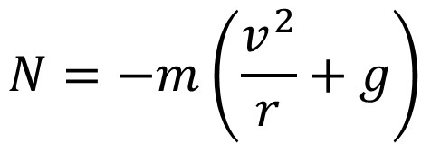
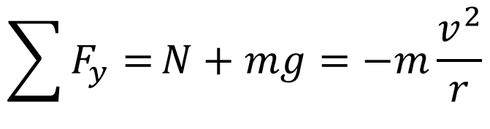
Problem solving uniform circular motion
A car of mass 1500 kg goes over a hill at a speed of 20 m/s. The shape of the hill is approximately circular, with a radius of 60 m, as in the figure at right. When the car is at the highest point of the hill,
What is the force of gravity on the car?
What is the normal force of the road on the car at this point?
$$\sum{F_{y}=}N+mg=−m\frac{v^{2}}{r}$$
$$N=−m\left(\frac{v^{2}}{r}+g\right)$$
Slide 6-30

Slide 24
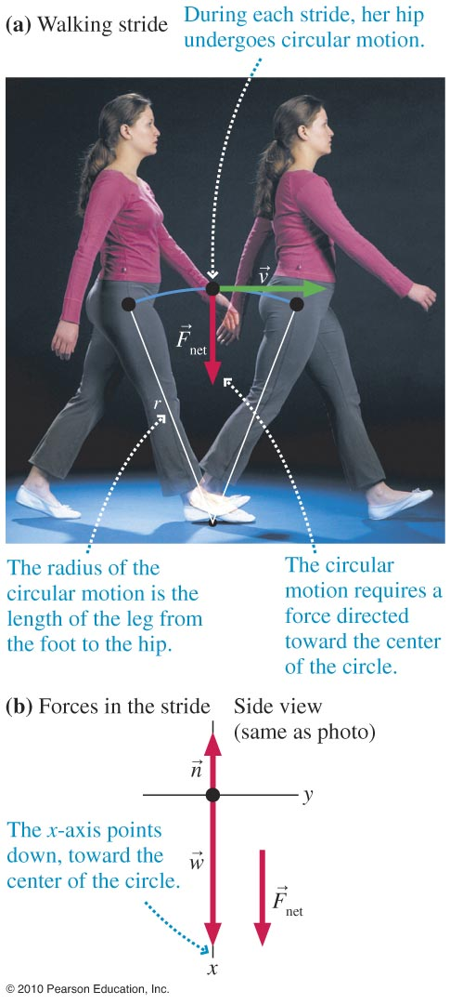
Maximum walking speed
Slide 6-31

Slide 25
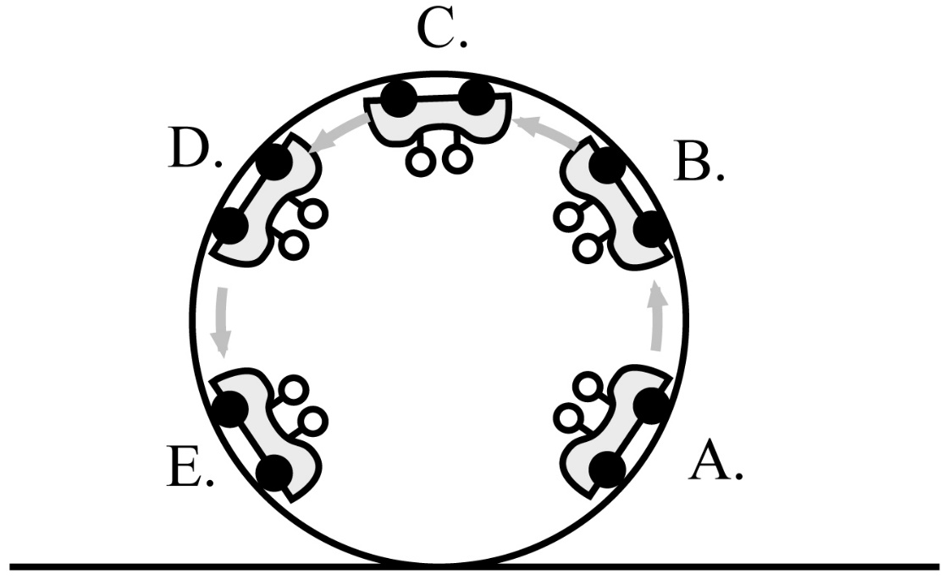
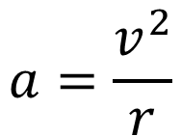
Example Problem
A roller coaster car goes through a vertical loop at a constant speed. For positions A to E, rank order the:
centripetal acceleration
normal force
apparent weight
$$a=\frac{v^{2}}{r}$$
A = B = C = D = E
Slide 6-32
Notes:
Answer:
Centripetal acceleration: same for all
Normal force: A & E, D & B, C
Apparent weight: A & E, D & B, C

Slide 26
Example Problem
A roller coaster car goes through a vertical loop at a constant speed. For positions A to E, rank order the:
centripetal acceleration
normal force
apparent weight
A = E > B = D > C
Slide 6-32
Notes:
Answer:
Centripetal acceleration: same for all
Normal force: A & E, D & B, C
Apparent weight: A & E, D & B, C

Slide 27
Example Problem
A roller coaster car goes through a vertical loop at a constant speed. For positions A to E, rank order the:
centripetal acceleration
normal force
apparent weight
A = E > B = D > C
Slide 6-32
Notes:
Answer:
Centripetal acceleration: same for all
Normal force: A & E, D & B, C
Apparent weight: A & E, D & B, C

Slide 28
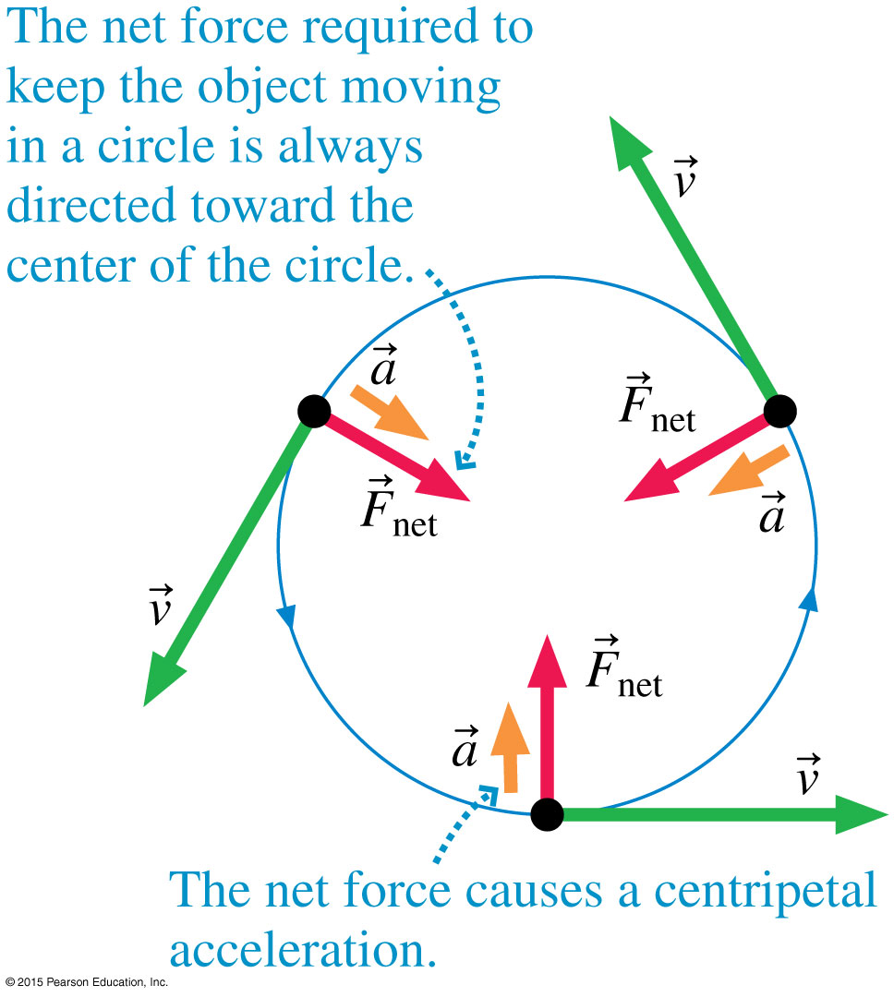
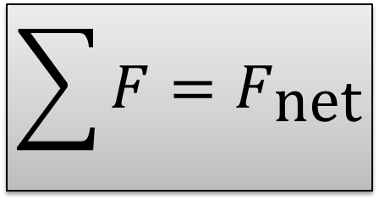
Net Force causes centripetal acceleration
$$\sum{F}=F_{\text{net}}$$
Notes:
FIGURE 6.5

Slide 29
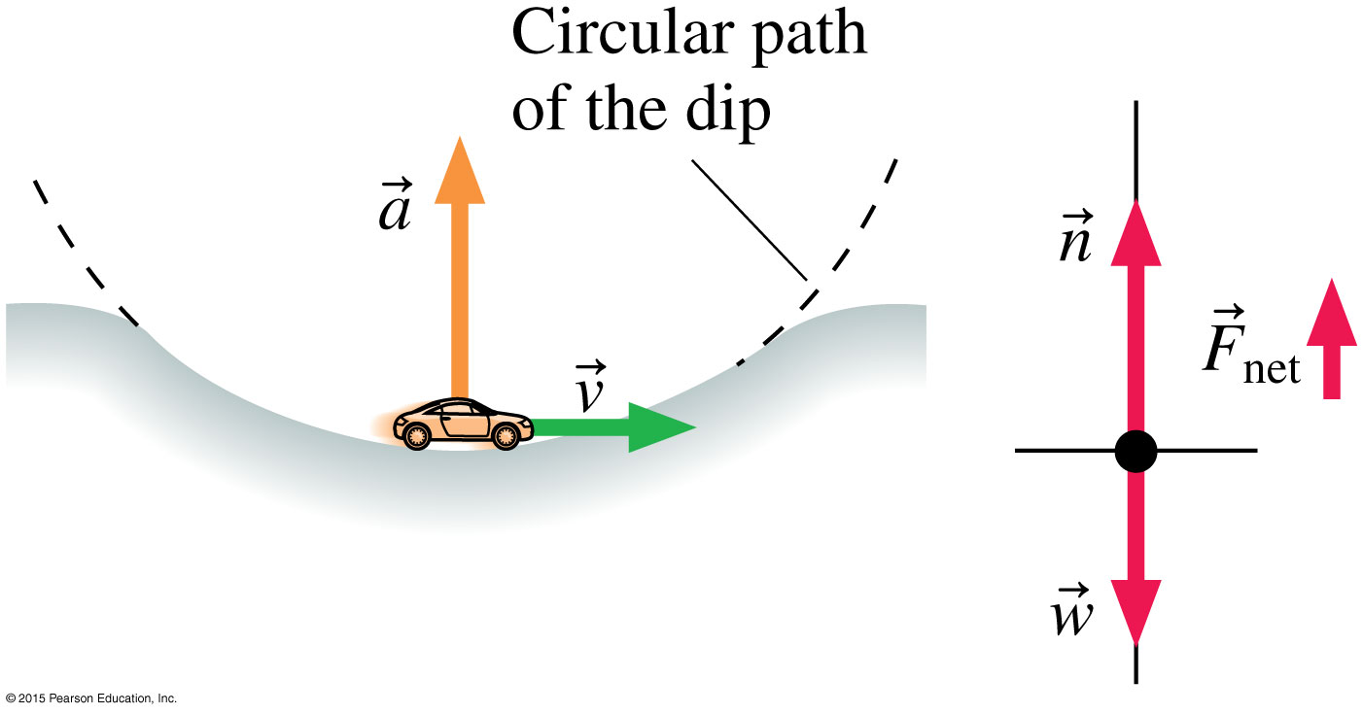
Net Force causes centripetal acceleration
Notes:
FIGURE 6.6

Slide 30
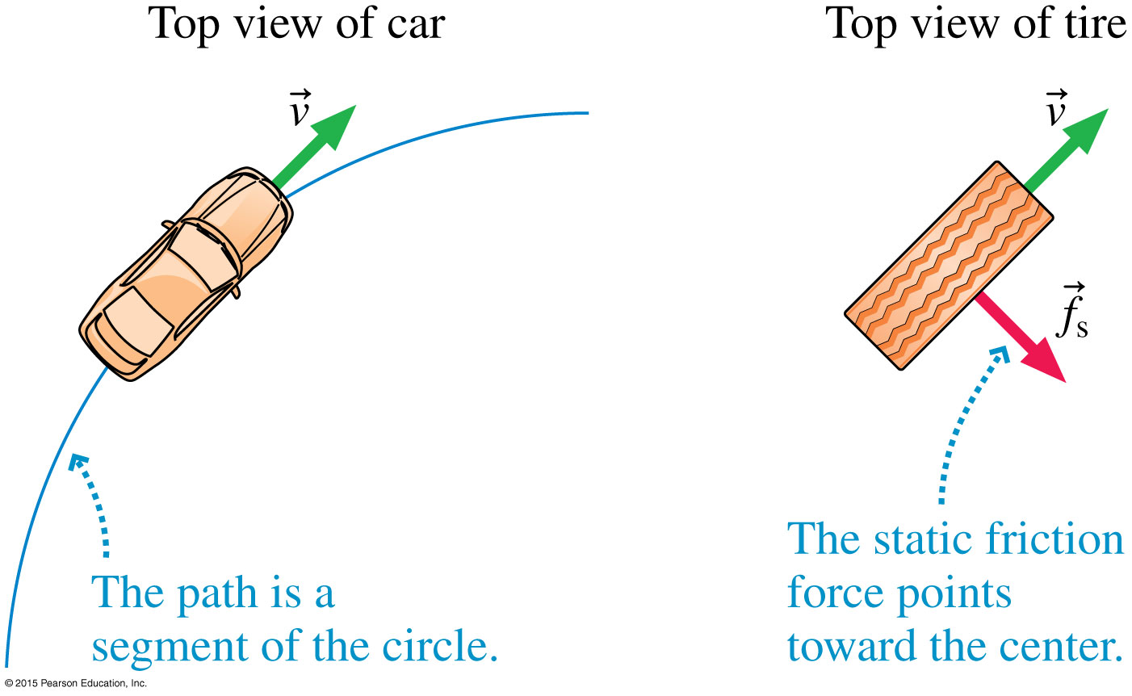
Friction force as a Net Force
Notes:
FIGURE 6.7

Slide 31
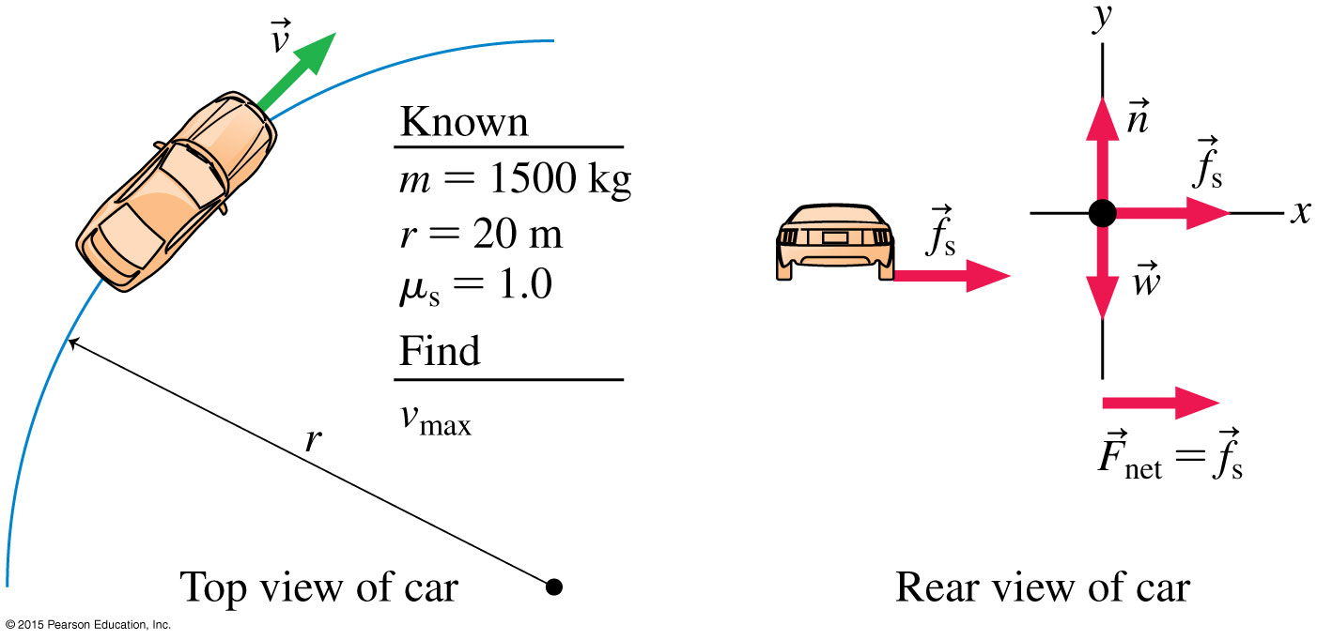

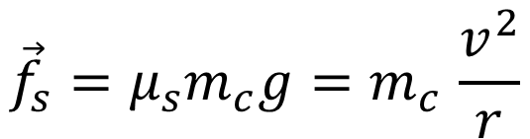
Problem solving circular motion with Net Force
$${\vec{f}}_{s}=μ_{s}m_{c}g{=m}_{c}\frac{v^{2}}{r}$$
$$v=\sqrt{μ_{s}gr}$$
Notes:
FIGURE 6.9

Slide 32
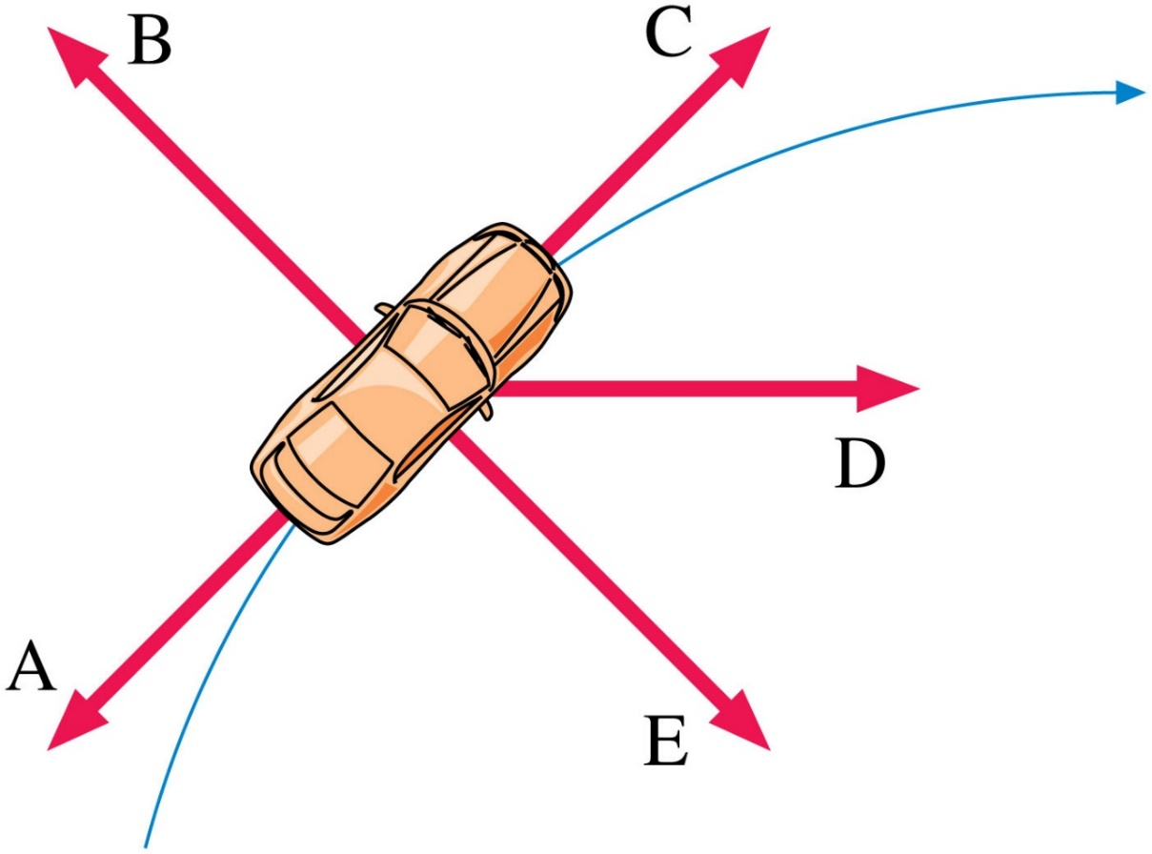
A car travels around a corner with the cruise control on. Which vector is the car’s centripetal acceleration?
A
B
C
D
E

Slide 33

A car travels around a corner while speeding up. Which vector is the net force on the car?
A
B
C
D
E

Slide 34
A car travels around a corner while speeding up. Which vector is the force of friction from the road on the car?
A
B
C
D
E

Slide 35
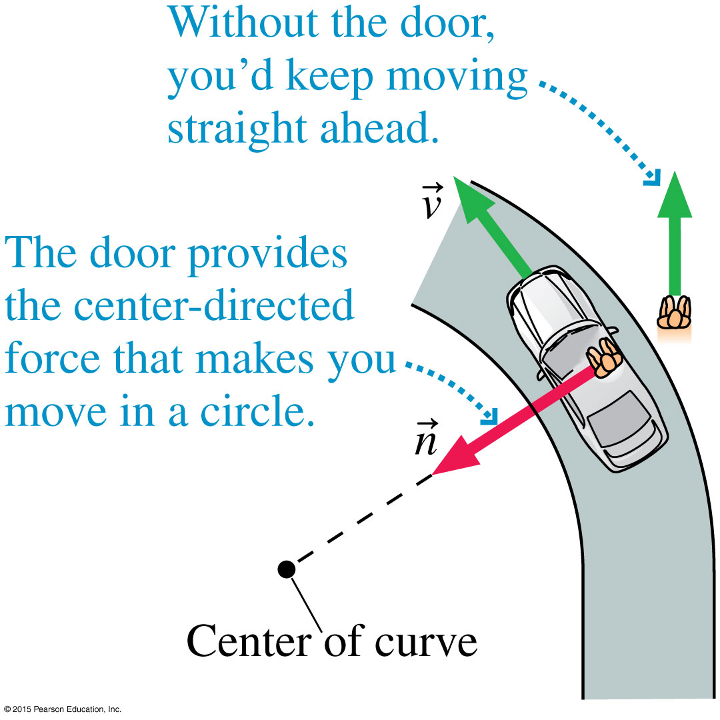
Fictitious Forces in circular motion
Feels like something is pushing you out of the car
Notes:
FIGURE 6.15

Slide 36
A car travels around a corner at a constant speed. Which vector is the fictitious force on the car?
A
B
C
D
E

Slide 37
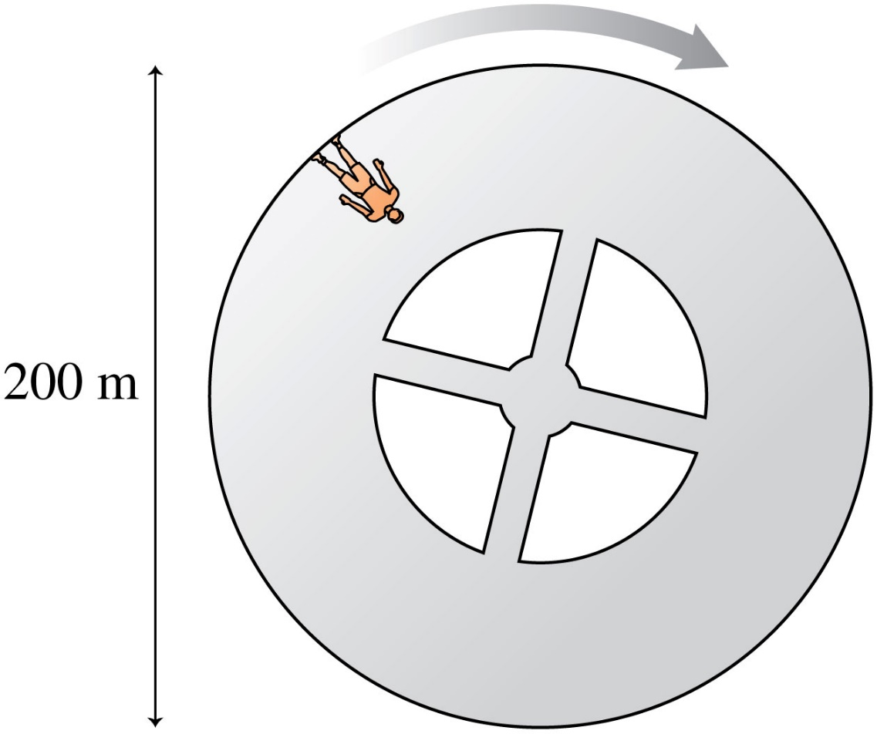

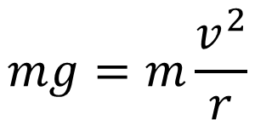



Simulating Gravity
This one guy you knew from a while back says that in order to avoid loss of bone density on his trip to mars so, the ship must be spinning to simulate gravity. How fast must the craft below spin to simulate gravity?
$$F_{g}=N$$
$$v$$
$$mg=m\frac{v^{2}}{r}$$
$$N$$
$$v=\sqrt{gr}$$
Notes:
FIGURE Q6.25

Slide 38
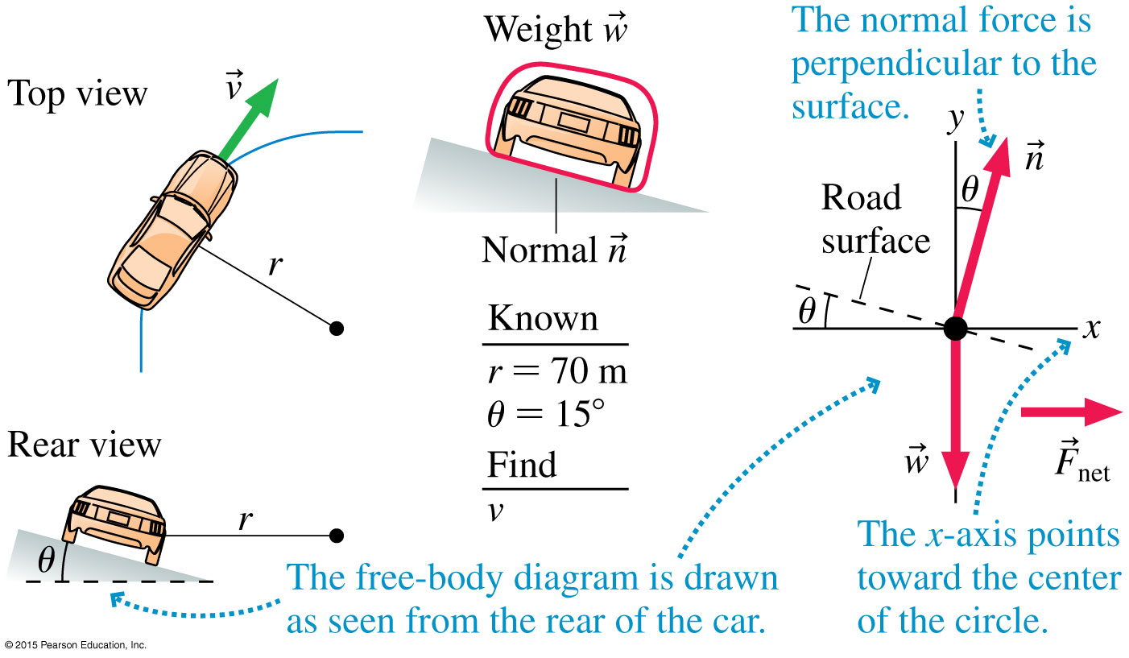
Tilted roads in favor of circular motion
Notes:
FIGURE 6.11

Slide 39
Example Problem: Over the Top
A handful of professional skaters have taken a skateboard through an inverted loop in a full pipe. For a typical pipe with diameter 14 ft, what is the minimum speed the skater must have at the very top of the loop?
Slide 6-33

Slide 40
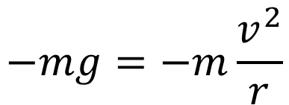



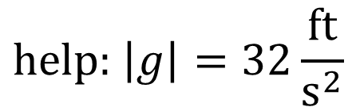

Example Problem: Over the Top
A handful of professional skaters have taken a skateboard through an inverted loop in a full pipe. For a typical pipe with diameter 14 ft, what is the minimum speed the skater must have at the very top of the loop?
$$\sum{F}=F_{g}=m\frac{v^{2}}{r}$$
$$N=0$$
$$F_{g}$$
$$−mg=−m\frac{v^{2}}{r}$$
$$v=\sqrt{\left|g\right|r}$$
$$\text{help}\text{: }\left|g\right|=32\frac{\text{ft}}{{\text{s}}^{2}}$$
Slide 6-33

Slide 41


Keeping riders safe in circular motion
Notes:
FIGURE 6.16A

Slide 42
When a ball on the end of a string is swung in a vertical circle, the ball’s acceleration is because
The speed is changing
The direction is changing
The speed and direction are changing
The ball is not acceleration

Slide 43


The Force of Gravity
Slide 6-35

Slide 44





The inverse-square law
Same as the familiar y and x
$$y$$
$$x$$
Notes:
Chapter 6 Unnumbered Equation, Page 176

Slide 45




$g$ versus $G$ in Newton’s law of gravitation
$g$ is a value unique to the mass that’s pulling
$G$ is the same throughout the whole universe!
Notes:
FIGURE 6.22

Slide 46

Example Problem
A typical bowling ball is spherical, weighs 16 pounds, and has a diameter of 8.5 in. Suppose two bowling balls are right next to each other in the rack. What is the gravitational force between the two—magnitude and direction? What is the magnitude and direction of the force of gravity on a 60 kg person?
Slide 6-36

Slide 47

A 60 kg person stands on each of the following planets. Ranks order her weight on the three bodies, from highest to lowest
A>B>C
B>A>C
B>C>A
C>B>A
C>A>B

Slide 48

Which vector pair matches the car’s motion over the hill?
A
B
C

Slide 49

Notes:
FIGURE 6.19

Slide 50



The Force of Gravity
$$v=\sqrt{\frac{GM_{\text{e}}}{r_{\text{e}}}}\sim 17,000\text{mph}$$
Notes:
Chapter 6 Opener 4

Slide 51


Example Problem: Orbital Motion
Phobos is one of two small moons that orbit Mars. Phobos is a very small moon, and has correspondingly small gravity—it varies, but a typical value is about 6 mm/s². Phobos isn’t quite round, but it has an average radius of about 11 km. What would be the orbital speed around Phobos, assuming it was round with gravity and radius as noted?
$$v=\sqrt{\frac{GM}{r_{\text{e}}}}=\sqrt{\frac{\left(6.67∙10^{−11}\frac{m^{3}}{\text{kg}∙{\text{s}}^{2}}\right)\left(\frac{.006}{9.8}∙5.97∙{10}^{24}\text{kg}\right)}{6.4∙{10}^{6}\text{m}}}$$
Slide 6-34

Slide 52
A satellite orbits the earth. A space shuttle crew is sent to boost the satellite into a higher orbit. Which of these quantities increases?
Speed
Angular speed
Period
Centripetal acceleration
Gravitational force of the earth

Slide 53

Summary
Slide 6-41

Slide 54

Summary
Slide 6-42

